Slide 1


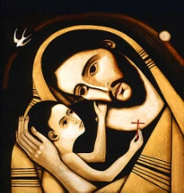



ST JOSEPH’S CATHOLIC PRIMARY SCHOOL, CLYDACH
YSGOL GYNRADD GATHOLIG SAN JOSEFF, CLYDACH
September 11th 2026
School Attendance: 92.9%
Reception: 97.1% Year 1: 89.4% Year 2: 99.2%
Year 3: 99.4% Year 4: 91.9% Year 5: 87.2% Year 6: 90.3%
Winning Class for Attendance:
Year 3: 99.4%
Da iawn!
Our Virtues for
September &
October
Faith-filled: We are faith-filled when we are living life as God inspires us to live it, putting the Gospel into action through our actions. We have to build on it every day through prayer.
Hopeful: We are hopeful when we are optimistic about the future, we trust ourselves and others, and we don’t give up. Our faith teaches us that God is hope.
Upcoming dates:
Tuesday 15th September: Years 5 & 6 St Jo’s Comp PT Peri (Music) Roadshow
Wednesday 16th September: Years 5 & 6 Theatre Na Nog trip
Thursday 17th September: First Mass of the School Year 9.30 St. Benedict’s. Years 2-6
Thursday 24th September: BV Transition Day for all Year 6 pupils. BV Open Evening 6-8 pm
Tuesday 29th September: Years 3 – 6 visit to Sketty Mosque.
FAMILY MASS the weekend of 3rd/4th October date TBC. This will be a Harvest Mass/Cafod Family Fast Mass and we will be asking for tins/packets for those who have less than us.
“

Slide 2
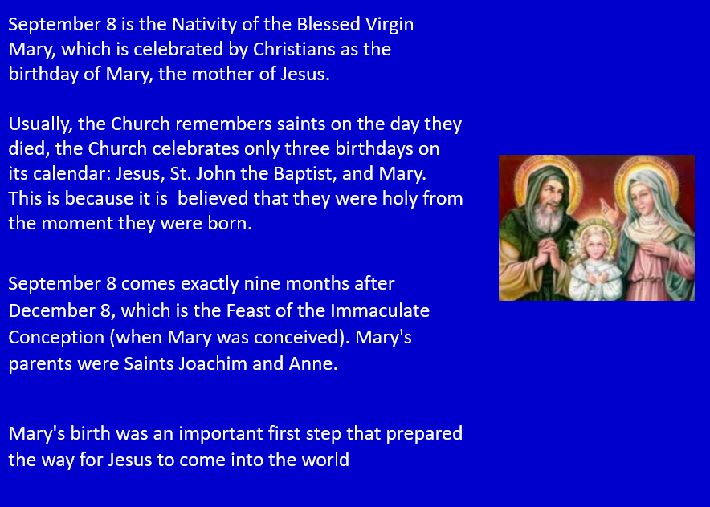
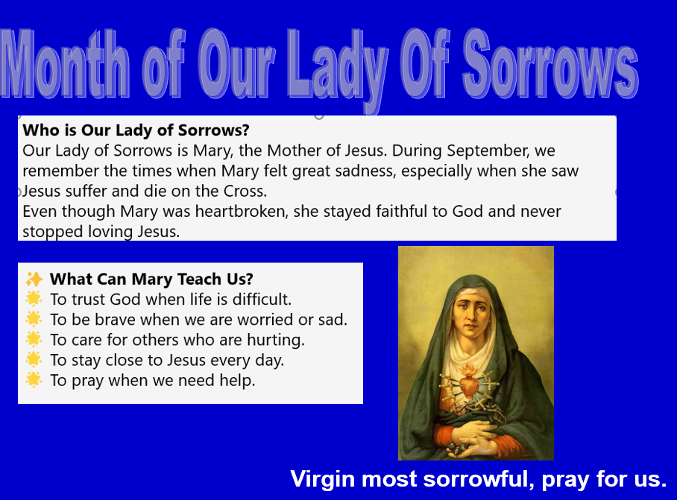


Slide 3
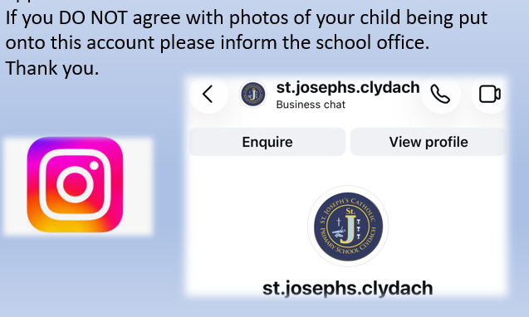
Updates of the week:
On our school website important dates are on the calendar and photos are on the ‘News & Events’ area.
https://www.stjosephscatholicps-swansea.co.uk/
You can also keep up to date with events on our school Instagram page.
https://www.instagram.com/reel/DZ9_t7dotBV/?igsh=OGdpOXNsbHdsb3F4
A big thank you to the parents who came to the Phonics Parent meeting and to see the School Nurse. We hope you found it very useful when reading with your children. Paper copies will also be given to Foundation pupils. The link below is the Powerpoint that was used, if those who couldn’t make it would like to see.
https://www.canva.com/design/DAHUgQbIKj0/slRW47yIgm_f_yqkbkL5TA/view?utm_content=DAHUgQbIKj0&utm_campaign=designshare&utm_medium=link2&utm_source=uniquelinks&utlId=h2e5b587be4

Slide 4
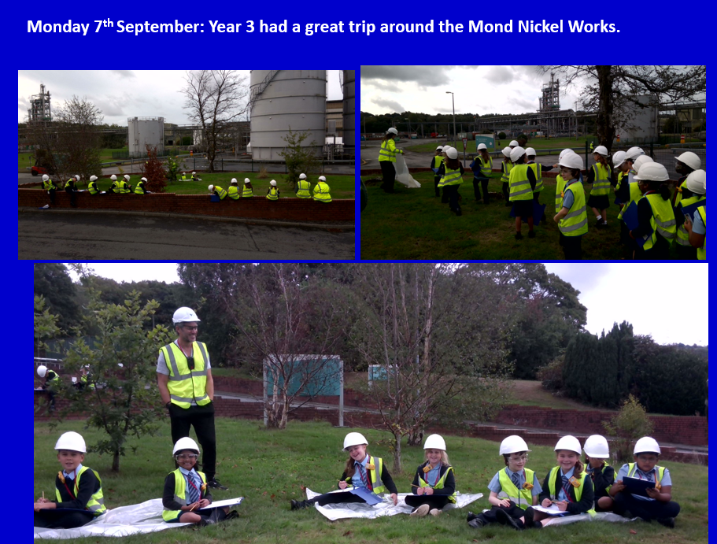
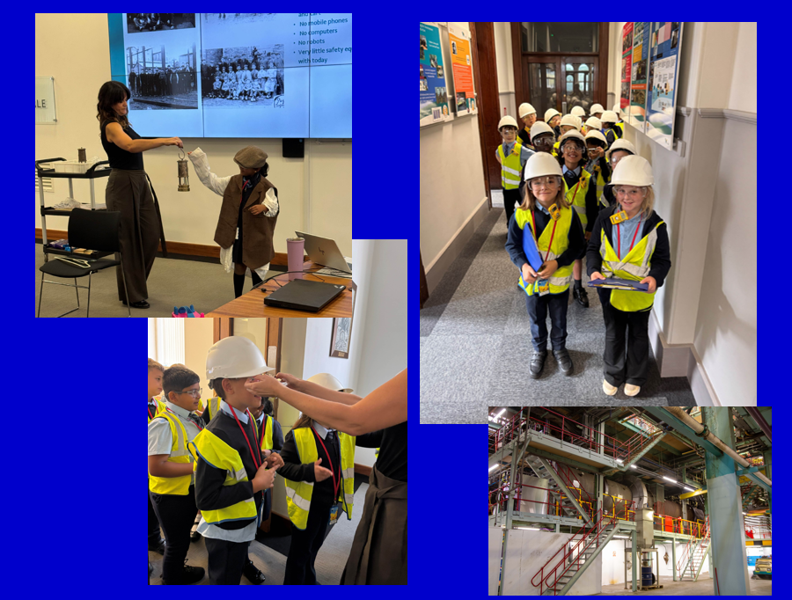

Slide 5
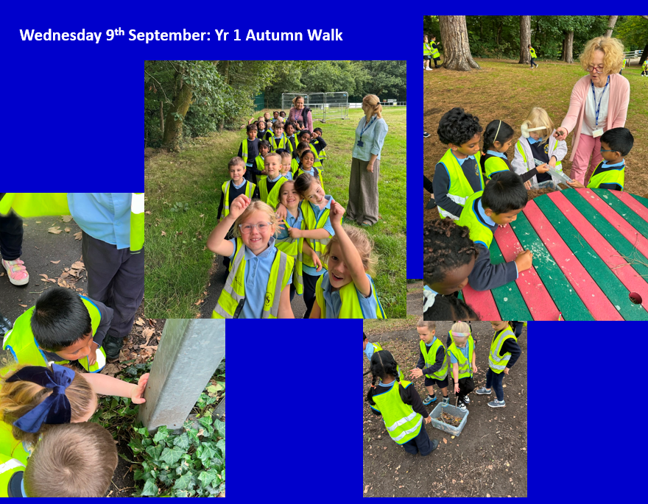

Slide 7
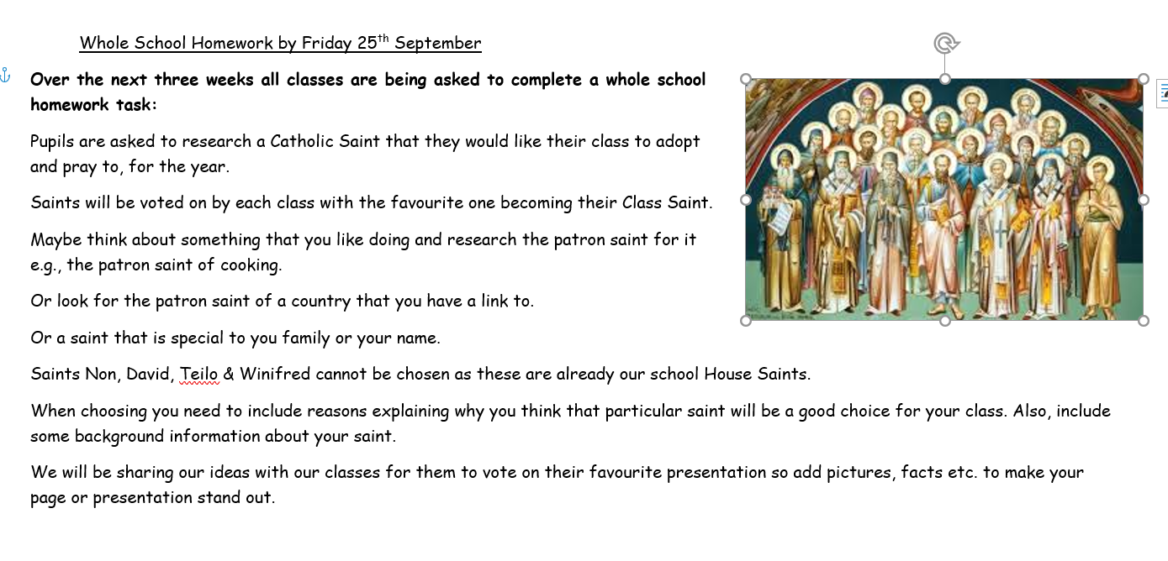

Slide 8


