Slide 1


Slide 2






ST JOSEPH’S CATHOLIC PRIMARY SCHOOL, CLYDACH
YSGOL GYNRADD GATHOLIG SAN JOSEFF, CLYDACH
September 4th 2026
School Attendance: 91.2%
Reception: 92.9% Year 1: 84.8% Year 2: 96%
Year 3: 96.8% Year 4: 89.1% Year 5: 90.6% Year 6: 90.3%
Winning Class for Attendance:
Year 3: 96.8%
Da iawn!
Our Virtues for
September &
October
Faith-filled: We are faith-filled when we are living life as God inspires us to live it, putting the Gospel into action through our actions. We have to build on it every day through prayer.
Hopeful: We are hopeful when we are optimistic about the future, we trust ourselves and others, and we don’t give up. Our faith teaches us that God is hope.
Upcoming dates:
Monday 7th September: Yr 3 trip to the Mond.
Tuesday 8th September: Phonics Parent Workshop in the Hall 9:00 – 10:00 am- ALL PARENTS FROM ALL AGES WELCOME, 10:00 am School Nurse
Thursday 10th September: Urdd Games sessions – Years 2, 4 & 6. Please wear Gym Kit
Tuesday 15th September: Years 5 & 6 St Jo’s Comp PT Peri (Music) Roadshow
Wednesday 16th September: Years 5 & 6 Theatre Na Nog trip
Thursday 17th September: First Mass of the School Year 9.30 St. Benedict’s
“

Slide 3
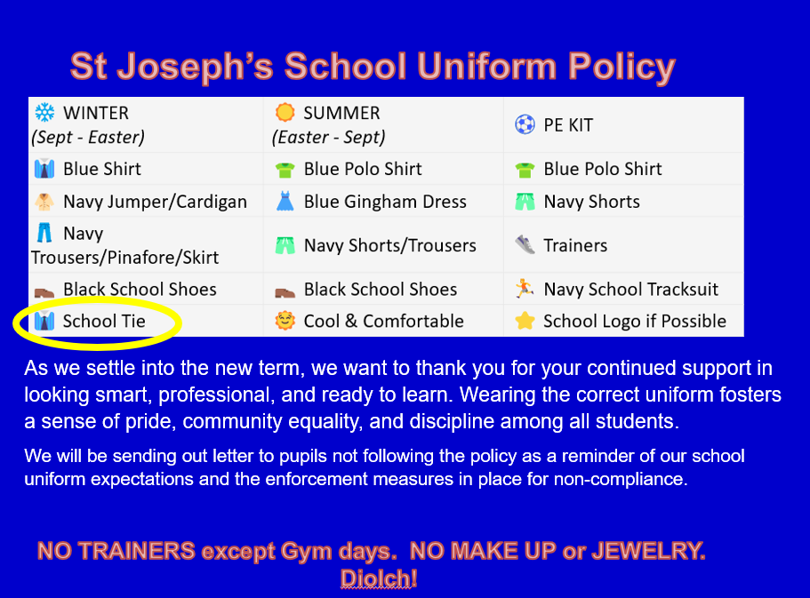

Slide 4



Slide 5

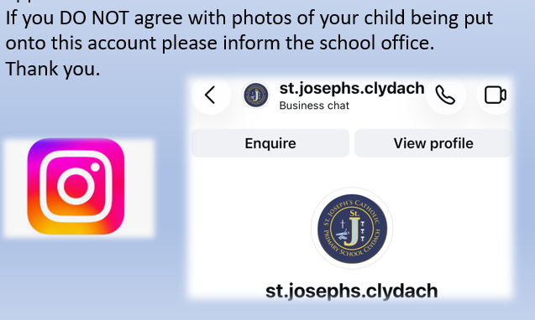
Updates of the week:
On our school website important dates are on the calendar and photos are on the ‘News & Events’ area.
https://www.stjosephscatholicps-swansea.co.uk/
Tuesday 8th September:
Phonics Parents Workshops & School Nurse Visit for September Nursery & Reception parents 9am- 10:45 am, School Hall.
This is an opportunity for parents of pupils from any class moving through the school to find out about helping their child learn to read- this session will be lead by a County specialist.
The School Nurse will also talk about help that can be given to younger pupils.
https://www.instagram.com/reel/DZ9_t7dotBV/?igsh=OGdpOXNsbHdsb3F4

Slide 6
Swansea Council: Schools Essentials Grant (previously known as the School Uniform Grant)
We recognise that there may be confusion in applying for this grant as it is for those learners that are eligible for free school meals. Being eligible for free school meals is different to the ‘Universal Free School Meal’ offer (this provides a free meal to all primary aged pupils). Children whose parents/carers receive the following support payments are eligible for free school meals. Universal Credit if your annualised net earnings are £7400 or less
Income support
Income based Job Seekers Allowance
Income related Employment and Support Allowance
Guarantee element of State Pension Credit
Support under Part VI or the Immigration and Asylum Act 1999
Child Tax Credit where total annual income is less that £16,190 a year
Working Tax Credit ‘run on’
If you believe you are eligible for free school meals we would urge you to apply (even if your child is in receipt of a free meal in primary school), the application form is quick and easy to complete, and eligibility allows you to apply for the Schools Essentials Grant. This will also help your school as part of the funding schools receive is based on the number of eligible free school meal learners. You can apply using the following link: Apply for free school meals - Swansea
If you have any queries relating to Free School Meals please contact: FreeSchoolMeals@swansea.gov.uk
Once eligibility status has been confirmed for free school meals, you will then be able to apply for the Schools Essentials Grant. This grant is available for those learners:
Eligible for free school meals
Children Looked After (CLA) (must attend a Swansea school)
Who are classed as No Resource to Public Funds (NPRF)
In year groups Reception – Year 11 (as of September 2025)
The grant is £125 per eligible learner except for those in Year 7, who will be entitled to £200.
The grant can be spent on (but is not limited to):
School uniform including coats and shoes;
School sports kits including footwear;
IT equipment;
Uniform for enrichment activities (for example scouts, guides, cadets, dance etc.); and
Equipment (for example school bags and stationery).
You can apply for the Schools Essentials Grant using the link below: School Essentials Grant (formerly school uniform grant - PDG access) - Swansea
If you have any queries relating to the Schools Essentials Grant please contact: schooluniformgrant@swansea.gov.uk

