Slide 1


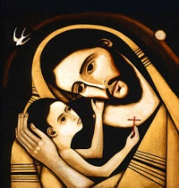

ST JOSEPH’S CATHOLIC PRIMARY SCHOOL, CLYDACH
YSGOL GYNRADD GATHOLIG SAN JOSEFF, CLYDACH
April 24th 2026
School Attendance: 92.4%
Reception: 86.9% Year 1: 89.2% Year 2: 95.8%
Year 3: 90.6% Year 4: 91.6% Year 5: 96.1% Year 6: 95.8%
Winning Class for Attendance:
Year 5: 96.1%
Da iawn!
Our Virtues for
April & May are:
We are growing to know and be grateful for our own gifts, for the gift of other people, and for the blessings of each day; and developing to the full so that we can be generous with our gifts, in the service of others.
Upcoming dates:
Thursday 7th May Image Theatre in school ‘Dr Dolittle’
Friday 8th May Eco Day! David Attenborough's 100th Birthday & World Earth Day
Friday 15th May Friends of St Joseph’s invite parents in to help around the school & yard with ‘jobs’
Friday 22nd May World Day for Culture & Dialogue -wear national costume or flag colours
Friday 19th June Sports Day (a.m.) & Gaelic Football Festival all day (more info to come)
Friday 19th June Sunflower Day (theme to be decided by the pupils)
“

Slide 2
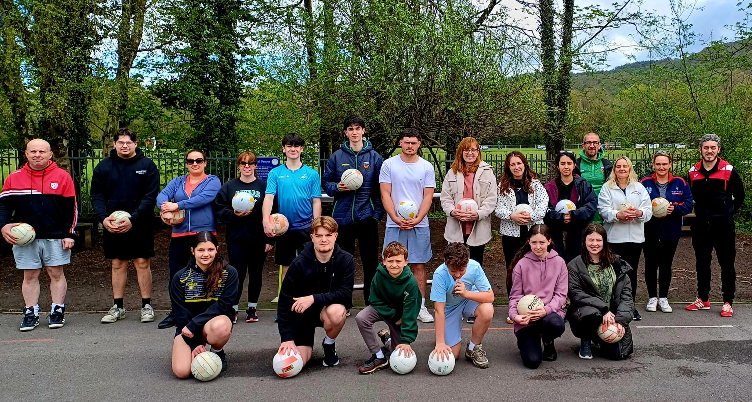
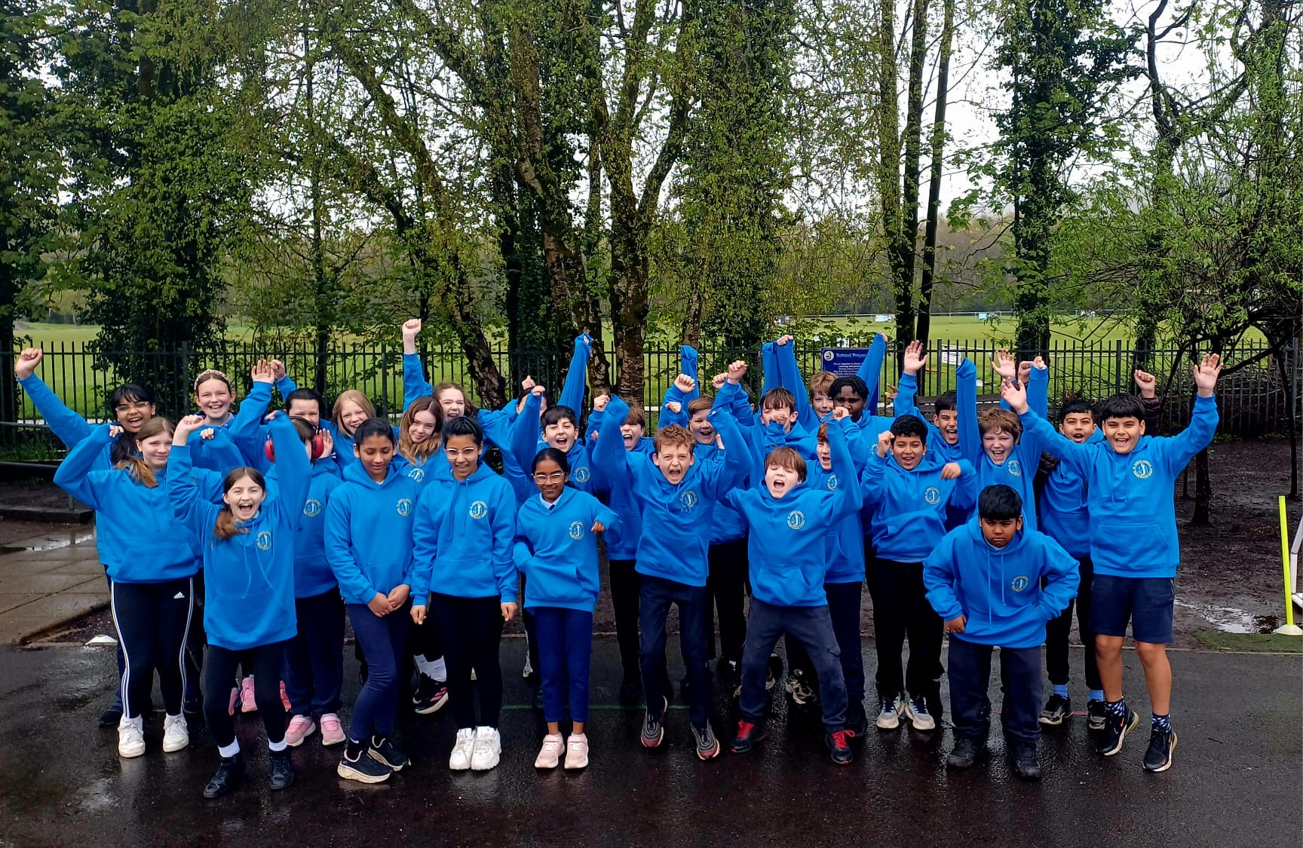

Updates of the week:
On our school website important dates are on the calendar and photos are on the ‘News & Events’ area.
https://www.stjosephscatholicps-swansea.co.uk/
Year 6 have been presented with their leavers’ hoodies for their
last term. The hoodies are a gift from the school.
They seemed very happy with them!
Huge thanks to Mr. Maddock for leading the ‘Developing PE skills
using small sided games’ course last Saturday. We really appreciate him
giving up his time and thank you to staff, parents and pupils – both past
& present- who came and took part.
Image Theatre are visiting us on Thursday 7th
May to put on their latest play, ‘Dr Dolittle.’
There will be a £2 cost per child to enable us to
continue to give our pupils these wonderful
experiences of the Arts.

Slide 3
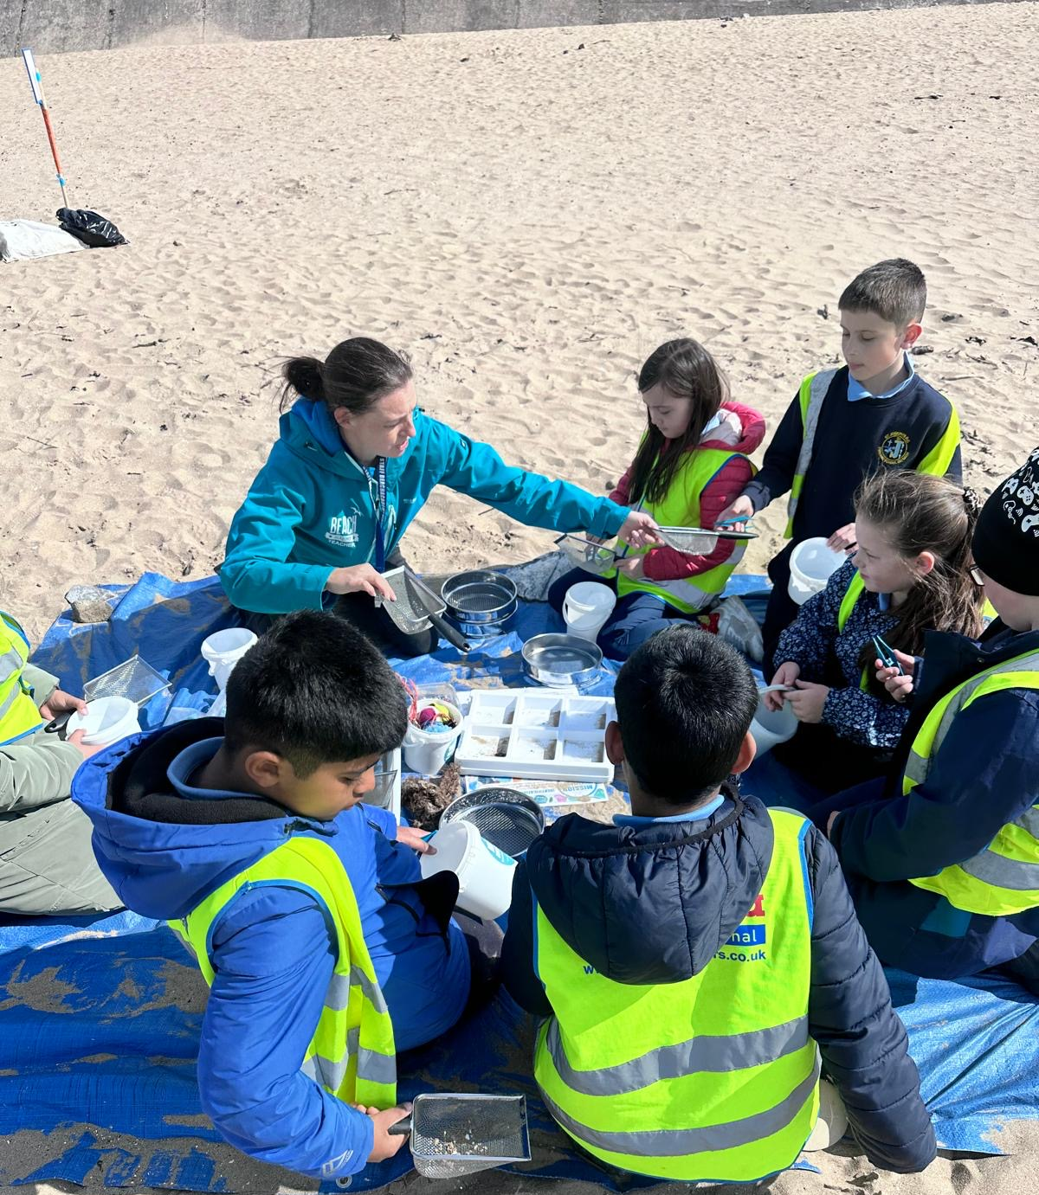
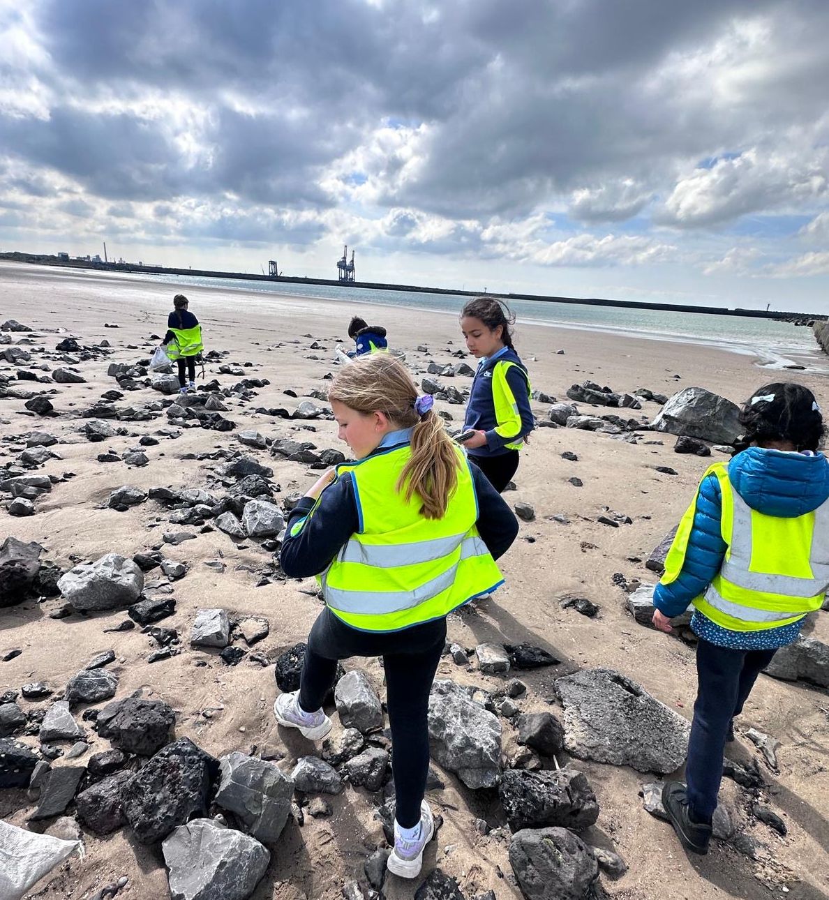
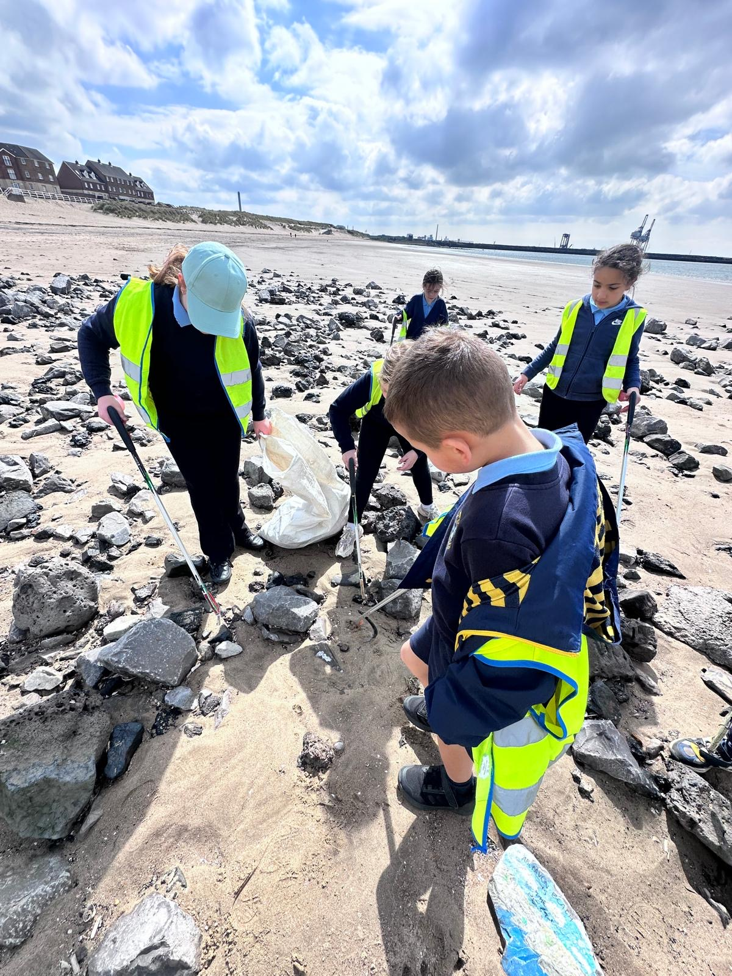
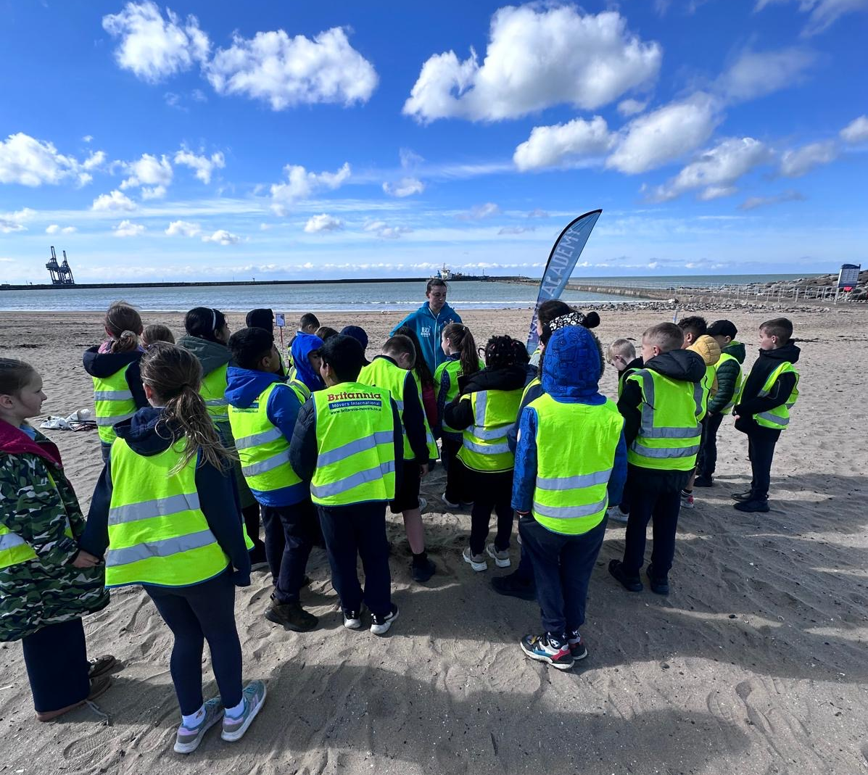
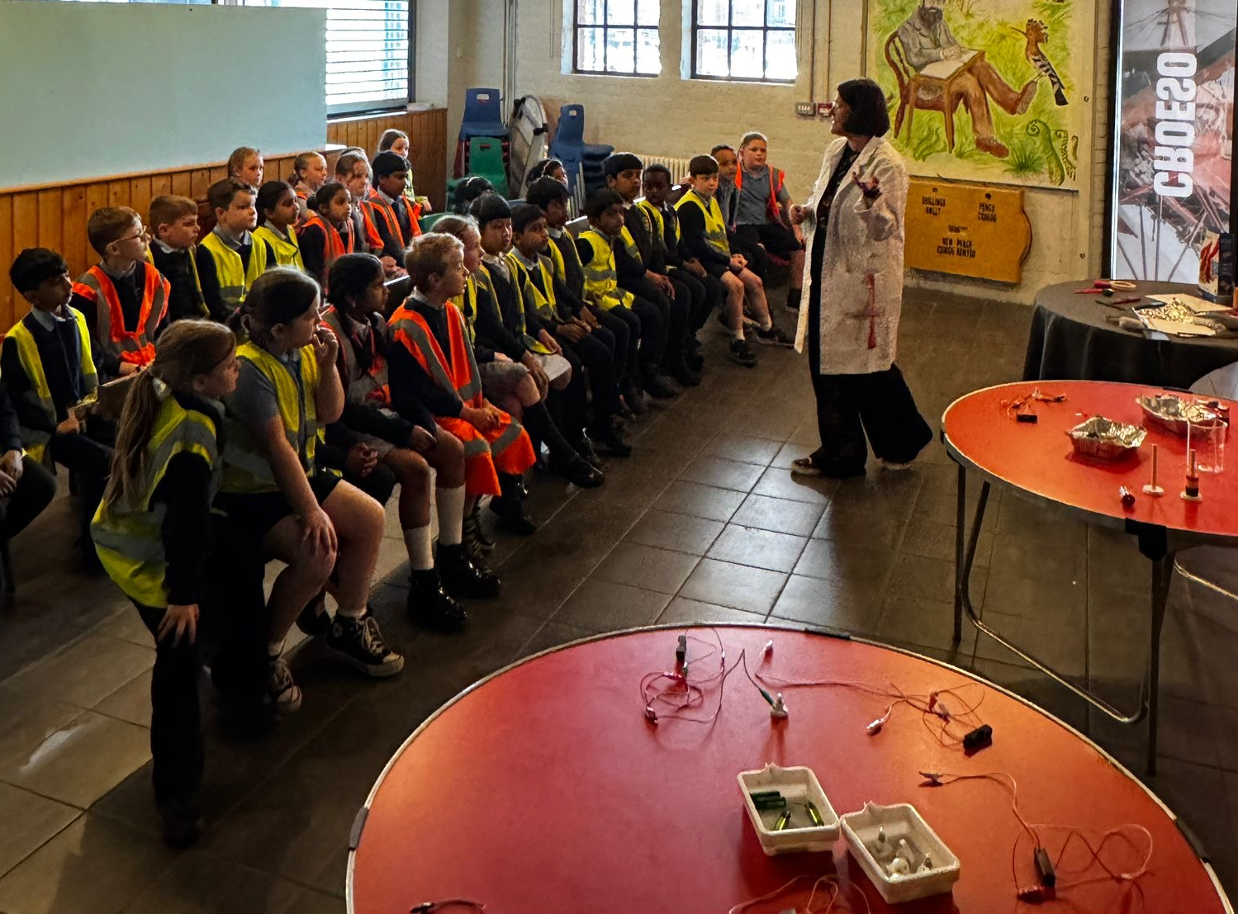
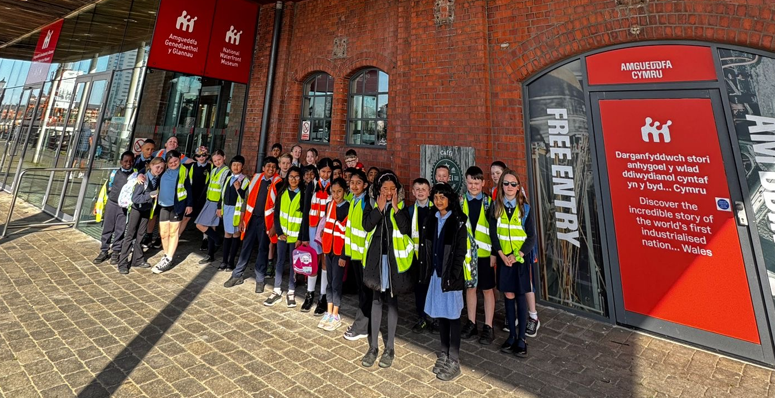
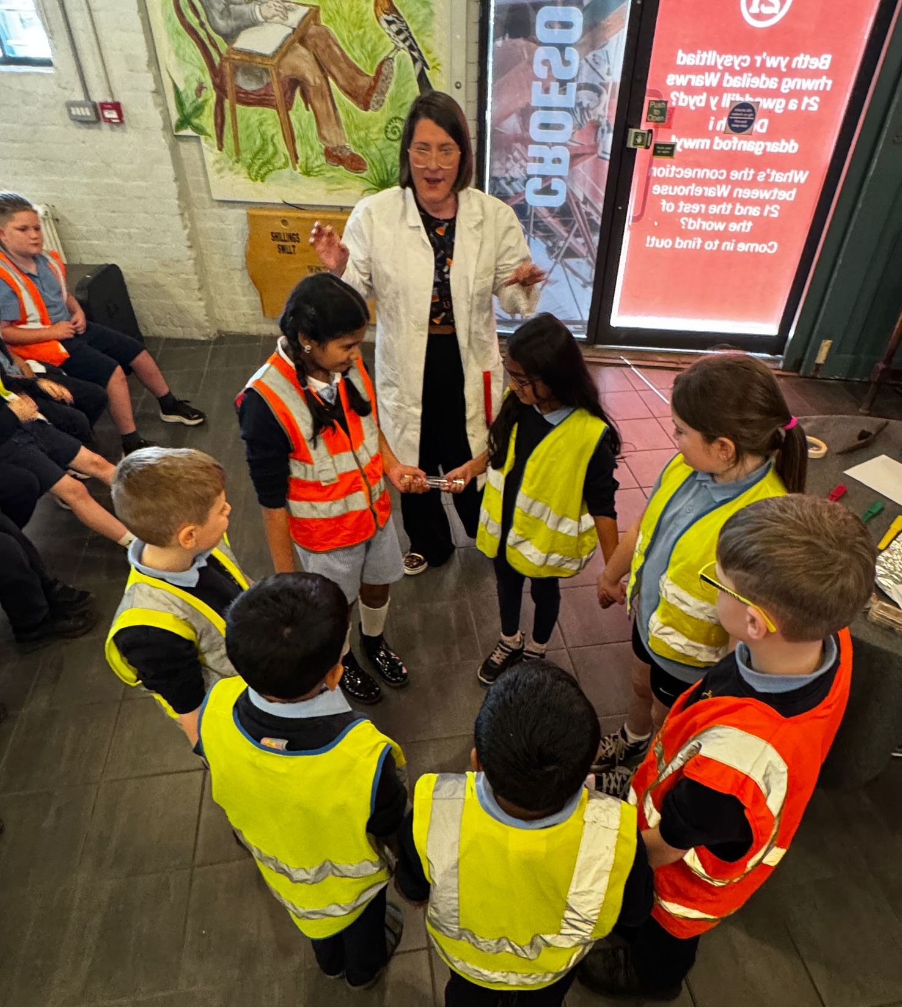
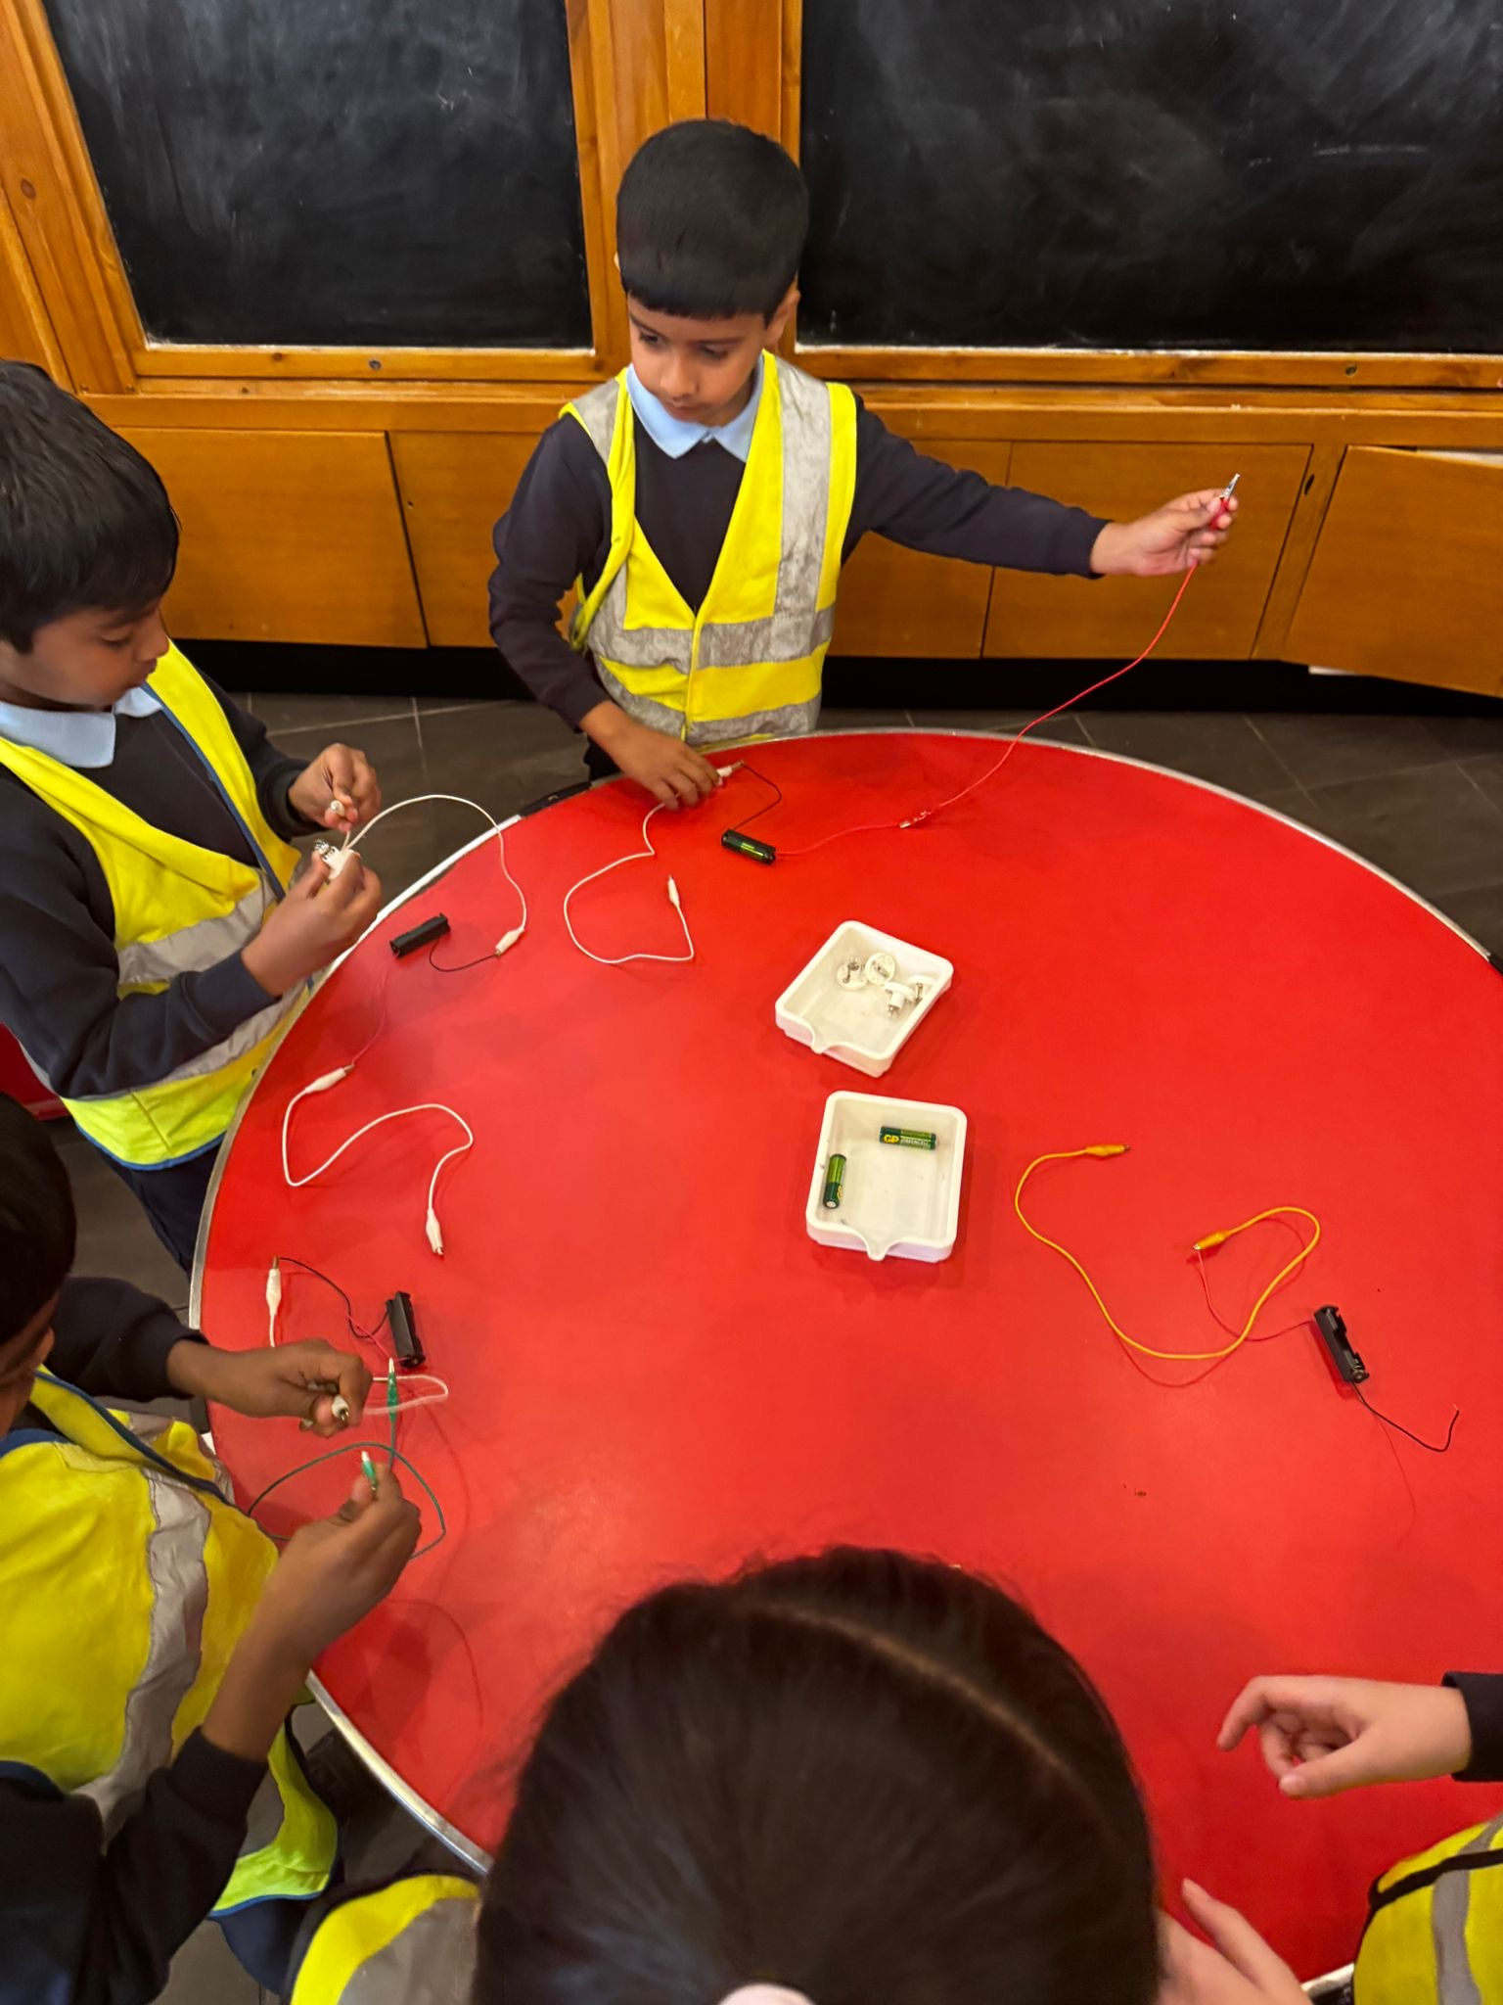
Year 4 visited Aberavon Beach on Tuesday to work with ‘Beach Academy Wales,’ on ocean conservation linked to their topic ‘Blue Abyss.’ By studying Aberavon Beach as a local coastal area, they explored the relationship between humans and the sea, including how pollution affects communities, wildlife and future generations.
Year 3 visited the Swansea Waterfront Museum for a ‘Marvellous Metals’ worship. They learnt all about metals and how important they were in the development of Copperopolis Swansea which was an lead the world in copper smelting, during the Industrial Revolution.

Slide 4
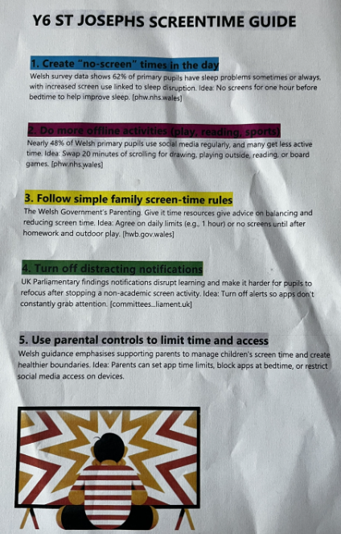
Year 6 recently completed a survey on their use of screen time –
the results were very interesting!
They analysed the data that they found and have written a
Guide with ideas to help us all.
This would be a good conversation starter in our homes!
Please see the important changes to our attendance/absence arrangements that have been text out and are on the website. Thank you for your cooperation. https://www.j2e.com/st-josephs-catholic-primary-school15/Mary/Absence+changes+letter.pdf/
Information for Year 6 pupils – please read. https://www.j2e.com/st-josephs-catholic-primary-school15/Mary/Wales+Vinnie+Camp+August+2026.pdf/ Yr 6 Wales’ Vinnie Camp

Slide 5
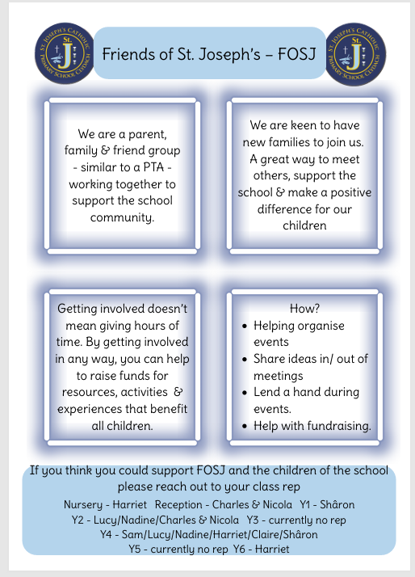
Please think about joining and helping to ensure that our pupils have lots of experiences and opportunities.
All are welcome!

Slide 6









Merit Award & ‘Seren Yr Wythnos’
Class | Seren yr Wythnos | Merit Award
Nursery
Reception | Stella | Mohammed Ameen & Isabelle
Year 1 | Betsiah | Evan & Roman
Year 2 | Giorgio & Milo | Aimee & Aimy
Year 3 | Naira | Angelin & Alexis
Year 4 | Ellis | Tori & Alissa
Year 5 | Nana Kwadwo | Erin & Tillie
Year 6 | Mylo | Sarah & Leif
.

Slide 7
Swansea Council: Schools Essentials Grant (previously known as the School Uniform Grant)
Please be reminded that the closing date for applying for the Schools Essentials Grant (previously known as the School Uniform Grant) is 31 May 2026 for the 2025-2026 Academic Year.
We recognise that there may be confusion in applying for this grant as it is for those learners that are eligible for free school meals. Being eligible for free school meals is different to the ‘Universal Free School Meal’ offer (this provides a free meal to all primary aged pupils). Children whose parents/carers receive the following support payments are eligible for free school meals. Universal Credit if your annualised net earnings are £7400 or less
Income support
Income based Job Seekers Allowance
Income related Employment and Support Allowance
Guarantee element of State Pension Credit
Support under Part VI or the Immigration and Asylum Act 1999
Child Tax Credit where total annual income is less that £16,190 a year
Working Tax Credit ‘run on’
If you believe you are eligible for free school meals we would urge you to apply (even if your child is in receipt of a free meal in primary school), the application form is quick and easy to complete, and eligibility allows you to apply for the Schools Essentials Grant. This will also help your school as part of the funding schools receive is based on the number of eligible free school meal learners. You can apply using the following link: Apply for free school meals - Swansea
If you have any queries relating to Free School Meals please contact: FreeSchoolMeals@swansea.gov.uk
Once eligibility status has been confirmed for free school meals, you will then be able to apply for the Schools Essentials Grant. This grant is available for those learners:
Eligible for free school meals
Children Looked After (CLA) (must attend a Swansea school)
Who are classed as No Resource to Public Funds (NPRF)
In year groups Reception – Year 11 (as of September 2025)
The grant is £125 per eligible learner except for those in Year 7, who will be entitled to £200.
The grant can be spent on (but is not limited to):
School uniform including coats and shoes;
School sports kits including footwear;
IT equipment;
Uniform for enrichment activities (for example scouts, guides, cadets, dance etc.); and
Equipment (for example school bags and stationery).
You can apply for the Schools Essentials Grant using the link below: School Essentials Grant (formerly school uniform grant - PDG access) - Swansea
If you have any queries relating to the Schools Essentials Grant please contact: schooluniformgrant@swansea.gov.uk

Slide 8
New clubs lists have started for the summer term. You need to send in the form and payment for your child to access clubs.
Club times are 3.20- 4.20PM Please be on time to collect your child from the main gate, diolch.
There are no clubs during HALF TERM – May 25th – 29th Last week of clubs will is July 6th.
MONDAY | TUESDAY
REC/Y1/2: LEGO CLUB | REC/Y1/2: BIBLE STORIES
Y3/4: ART CLUB | Y3/4: INDOOR & OUTDOOR GAMES
GY5/6: CREATIVITY & FITNESS | Y5/6: GAELIC FOOTBALL

